Slide 1

Solid as Steel: Production Planning at Thyssenkrupp
IIMK - DSBD Batch-1 Group 7
Pulkit Bansal, Vivek Jha, Deepti Koti, Uppu Umesh Mahesh, Sumit Bhandari, Subhas S, Ashish Kumar

Slide 2

Title
Problem Statement
The actual production throughput of one of the Bochum’s production line was far behind the planned in the last 10 years.
The production line is constantly underperforming.
Unfulfilled customer orders

Slide 3
Title
Manufacturing Process
Supply of Raw material(slabs) by train
PPL | Others
Batch process | Continuous process (Strips were welded one after the other)
Production downtimes due to push in problems | No production downtimes
High strength steel : thickness > 7 mm | Thickness < 7 mm
Different steel grades (top 5) | Single grade
Hot rolling mill- coiled strip with mill scale
Pain Point!!
PPL- Push Pickling Line – Uncoil - Remove scale – with hot HCl
Residual Removal + Oiling against corrosion + Re-coiling
Supply to B2B customers

Slide 4
Title
Null Hypothesis
MPT Theory:
Material with a low thickness or low width carries a lower weight per meter.
It takes longer to put 1 ton of material through the PPL.
High MPT is the cause for high negative delta throughput for shifts with high RTR
RTR Theory:
The lower the run time ratio, the higher the negative deviation from the plan

Slide 5
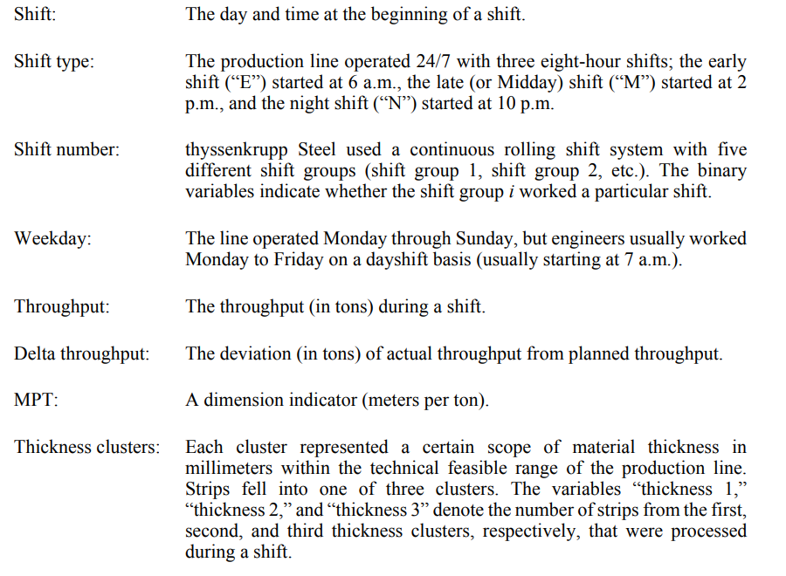
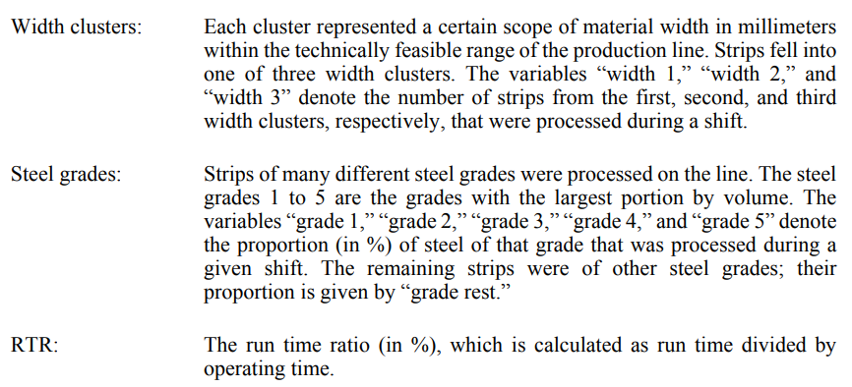
Title
Variables

Slide 6
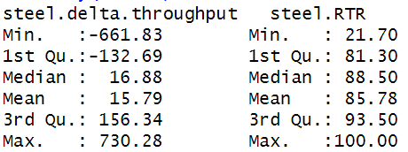
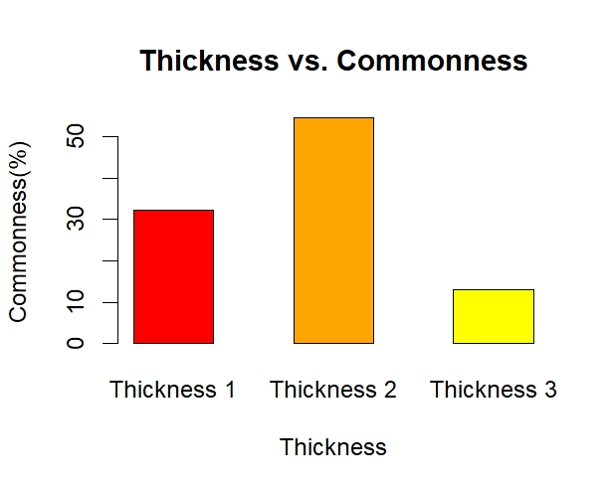
Title
Questions:
What is the average number of strips per shift?
36.832
~37strips/shift
2. Strip of which thickness cluster are the most common, and strips of which thickness cluster are the least common?
Thickness 1= 32.3 %
Thickness 2= 54.7 %
Thickness 3= 12.9 %
Thickness 2 is most commonly produced strip while Thickness 3 is the least commonly produced strip.
3. What are the min, max, and average values of delta throughput and RTR?

Slide 7
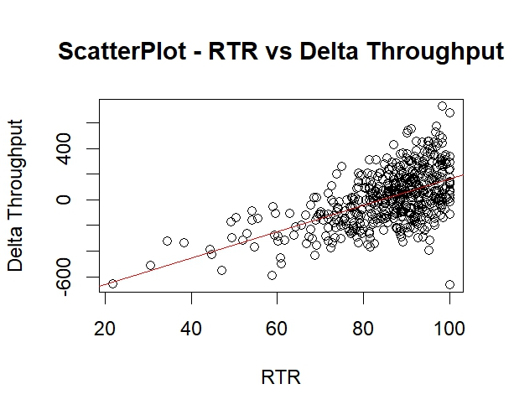

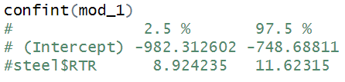
Title
Questions:
4. Are there shifts during which the PPL processes strips of only steel grade 1, or of only steel grade 2, etc.?
Only grades 1, 4, 5 and rest have shifts where only one grade steel is produced 100%.
5 . Can the RTR theory adequately explain the deviations from the planned production figures?
- There is a positive correlation between RTR and delta throughput.
0.556778
The linear regression model shows a positive correlation between the RTR and delta throughput.
When a shift is run efficiently without any production issues, the delta throughput is high.
Residuals:
Min 1Q Median 3Q Max -823.70 -130.00 1.61 118.48 585.88
Multiple R-squared: 0.31,
Adjusted R-squared: 0.3086
F-statistic: 223.7 on 1 and 498 DF, p-value: < 2.2e-16
p-value model is < 2.2e-16, very small.
A very small p-value means the rejection of the null hypothesis in favour of the alternative hypothesis.

Slide 8
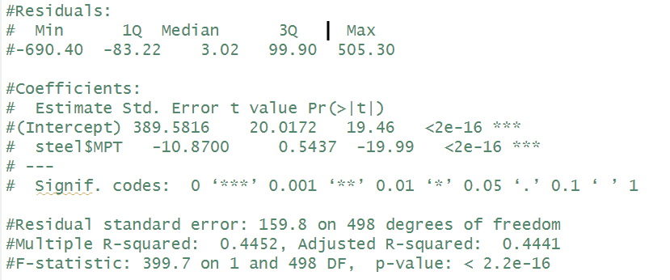

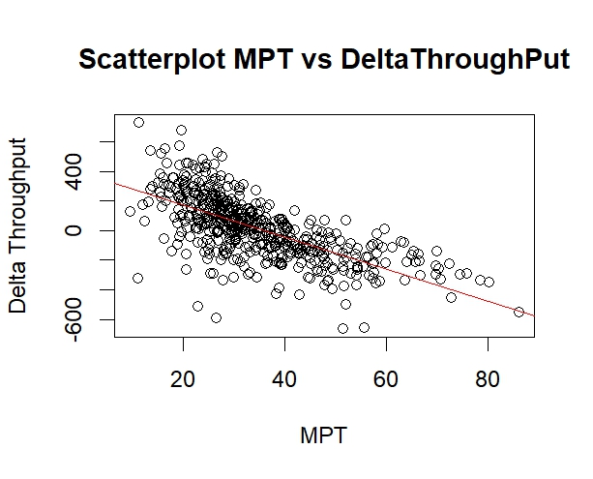
Title
Questions:
6. Is the MPT theory sufficient to explain the deviations? Explain why or why not.
We can say that if the MPT increases, the negative deviation is higher.
R-squared = 0.445
Though MPT is not the best fit of the model to the data but it also explains the variability in the Delta Throughput due to other parameters.

Slide 9
THANK YOU
Group 7

